Slide 1


End-to-end system of facial expression recognition in the natural images
Anastasiia Khaburska Andriy Yurkiv

Slide 2
Motivation
important part of interpersonal communication
excellent indicator of the human emotions or feelings
can be an effective way to improve human-computer or human-human interactions

Slide 3
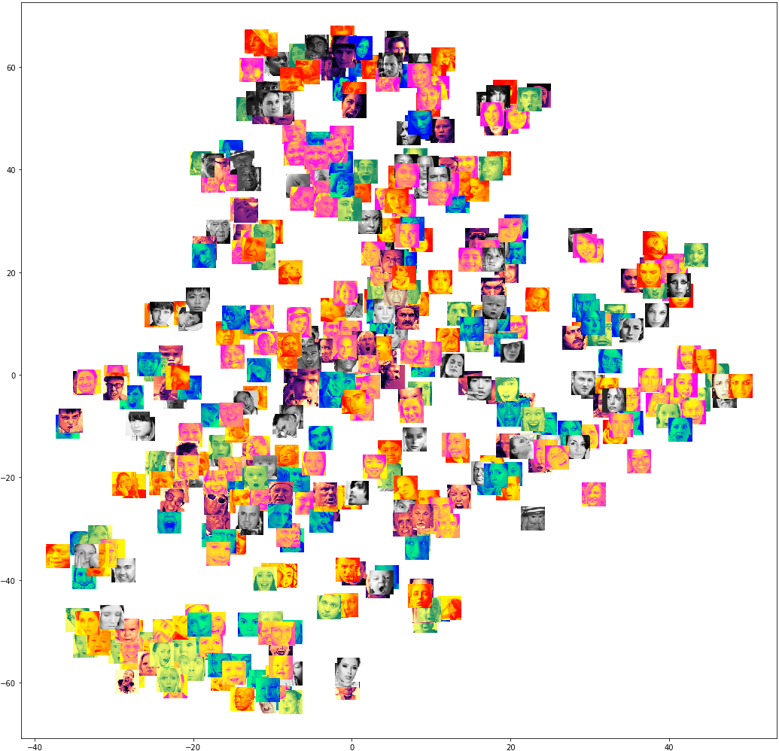
Motivation
for humans context is important
facial expressions are very substantially
cultural nuances
similarities between expressions

Slide 4

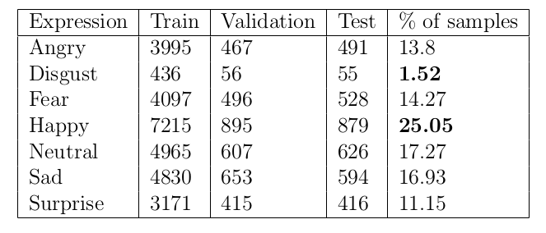
Data
Facial Expression Recognition Challenge: https://www.kaggle.com/c/challenges-in-representation-learning-facial-expression-recognition-challenge

Slide 5
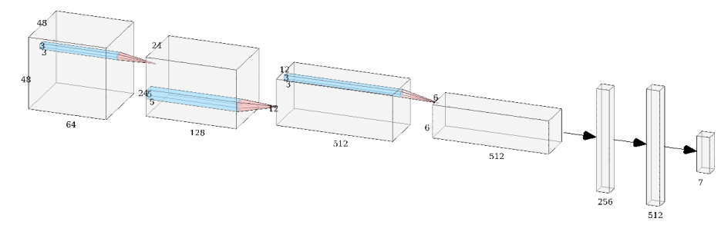
Baseline model
face detection : pre-trained Haar Cascade model (cv2)
facial expression: 4-layer CNN with 3 dense layers.
On each layer except output one we used ReLU activation function.
On the output layer we used Softmax function.
the Dropout regularisation technique at each layer.

Slide 6
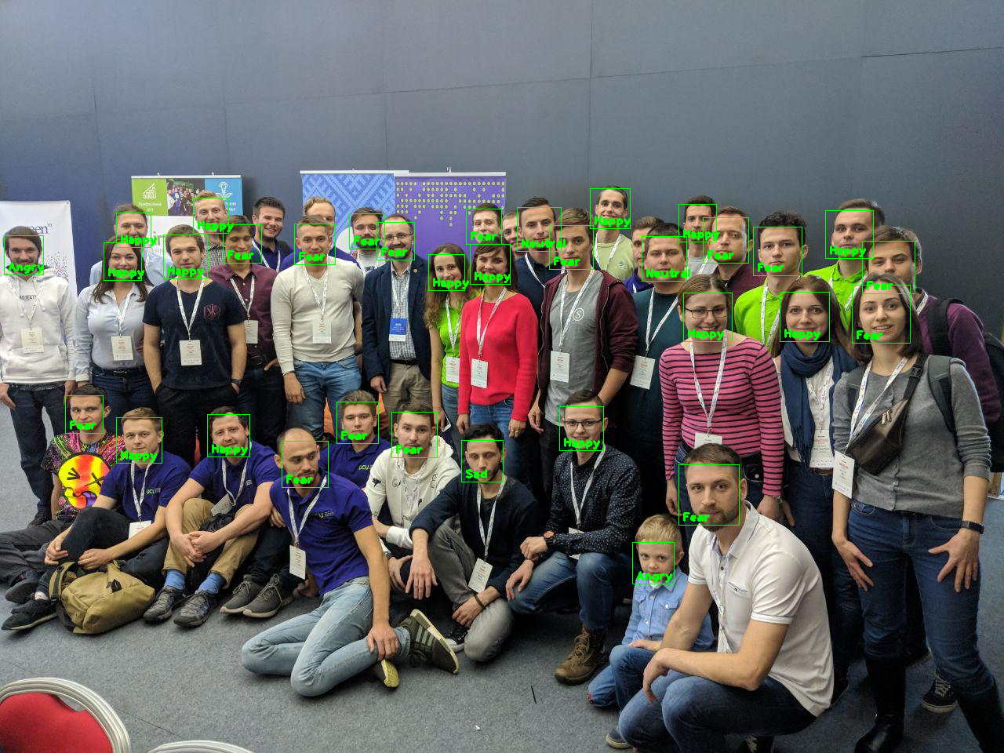
Evaluation
63.25% accuracy on the test dataset
in the top 10 submissions
small number of epochs
going to improve

Slide 7
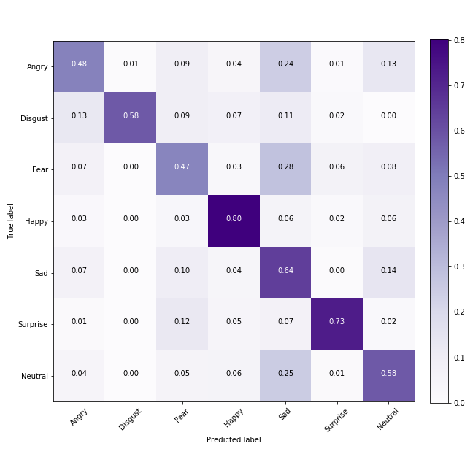
Evaluation. Confusion matrix
Fear is confused with Sad
3 out of 6 facial expressions are confused with Sad
Wrong assumption: Accuracy will be smaller for underrepresented classes

Slide 8
Future work
Perform data augmentation for underrepresented classes \item
Apply other CNN architecture to this problem: VGG, Inception, ResNet.
Increase number of features (Face Landmarks and HOG).
Write script for facial expression recognition in videos.
Perform some basic hyperparameter tuning.
Try to solve misclassification problem for Angry and Fear classes.

Slide 9
Thank you for attention

Slide 10
Thank you for attention

